Slide 1
Envisage Sec
By Karan Sanjay Suman (SS.23.165)
A Google Chrome Extension that helps you navigate the web securely

Slide 2
Purpose of Envisage Sec
Envisage Sec helps users stay safe online by checking the safety of websites using Google's Safe Browsing API.
It provides clear warnings if a site is dangerous, giving users more confidence while browsing.
The extension aims to protect users from phishing sites or websites with malware.

Slide 3
Benefits for users
Users can quickly and easily determine if a website is safe before entering personal information or downloading anything.
This can help users browse with more confidence and avoid potentially dangerous websites.

Slide 4



Overview of Google's Safe Browsing API
Google's Safe Browsing API is used by Envisage Sec to check website safety
It has a large database of known malicious websites, including phishing and malware sites
Envisage Sec uses this API to quickly determine if a website is safe or not

Slide 5
Importance of website safety
Website safety is crucial in protecting personal information and devices from potential threats
Envisage Sec provides a convenient way for users to quickly assess the safety of a website
Enhances online security and confidence in browsing

Slide 6
Functionality of Envisage Sec
Acts as a bodyguard for your browser
Checks the safety of the website using Google's Safe Browsing API
Notifies if the site is safe or dangerous
Provides quick risk assessment before entering personal information or downloading anything

Slide 7
Integration with Chrome browser
Click the Envisage Sec icon next to the address bar to check website safety
Uses Google's Safe Browsing API for website risk assessment
Provides clear message about the site's safety
Allows for quick and easy website risk assessment while browsing

Slide 8

Demo

Slide 9
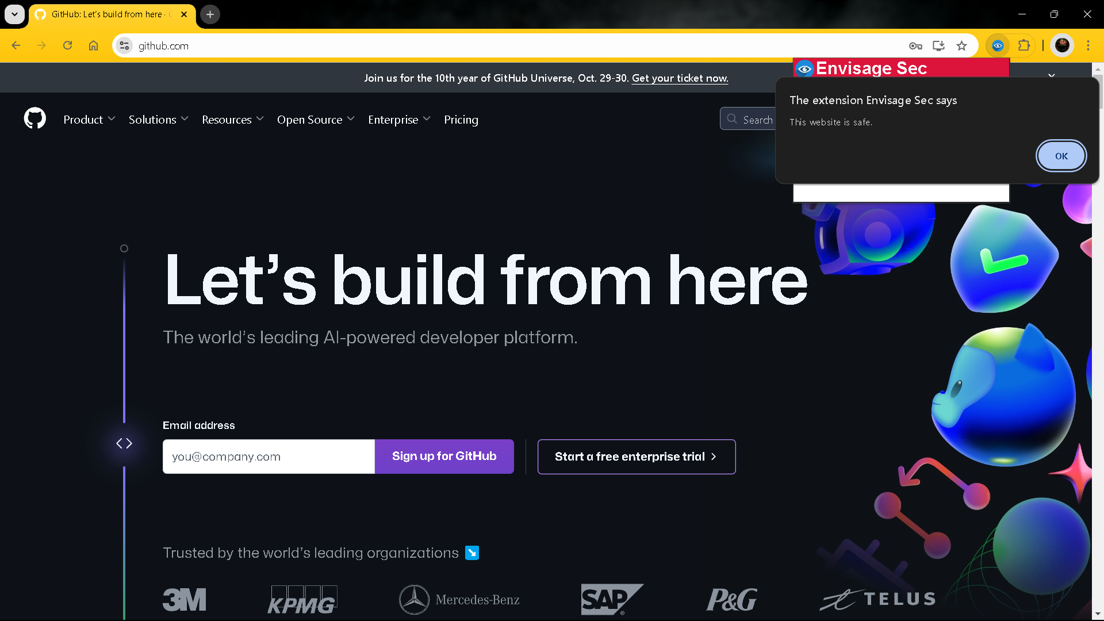
Demo

Slide 10
Future developments and improvements
Expanding the database of known bad websites to enhance protection
Adding additional security features for comprehensive online safety
Enhancing the ability to detect new threats in real-time
Integrating with other security tools and platforms for a more comprehensive solution

